Slide 1

Wholesale Management System: A Database-Driven Solution
by: nikhil upadhyay
m.c.a. semester ‘2’.

Slide 2
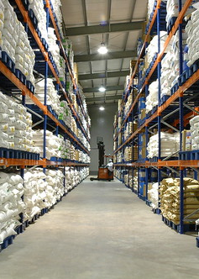
Introduction
This database is designed to manage essential data for a wholesale or retail business. Its core functionalities include:
Inventory Tracking: The 'product' and 'warehouse' tables enable effective inventory management with stock levels, product descriptions, and warehouse locations.
Supplier Management: The 'supplier' table stores comprehensive supplier details, facilitating procurement and supply chain optimization.
Customer Relationship Management (CRM): The 'customer' table provides a centralized repository for customer information, supporting sales and marketing efforts.
Sales and Order Processing: The 'order_table' and 'order_details' tables enable streamlined management of orders, including order dates, items, quantities, and total amounts.
Employee Management: The 'employees' table stores key employee data such as names, positions, contact details, and hire dates.
This Photo by Unknown Author is licensed under CC BY-ND

Slide 3
The challenge- Inefficiencies in Traditional Wholesale Management
Manual, paper-based processes: Prone to errors and time-consuming.
Disparate data silos: Difficulty obtaining a comprehensive view of inventory, sales, and customers.
Limited reporting and analytics: Hinders informed decision-making.
Challenges scaling with business growth.

Slide 4
Modules description
1. Inventory Management
Description: Controls product information, stock updates, warehouse locations, and reorder management
Functions:
Add new products
Update product descriptions and pricing
Adjust stock quantities (incoming shipments, sales deductions)
Generate low-stock alerts
Track inventory across multiple warehouses
2. Supplier Management
Description: Manages supplier information, sourcing, and contact management.
Functions:
Add/edit supplier records
Record contact information and communication history
Track supplier performance (lead times, product quality)
Link suppliers to specific products

Slide 5
Modules description contd…
3. Customer Management (CRM)
Description: Centralizes customer data and interactions.
Functions:
Add/edit customer profiles
Track purchase history
Generate customer order reports
Support targeted marketing or loyalty programs
4. Employee Management
Description: Maintains employee records and potentially sales performance tracking.
Functions:
Store employee data (names, positions, hire dates, etc.)
Track sales performance by employee (if applicable)
Manage employee permissions within the system (if you have a user interface)

Slide 6
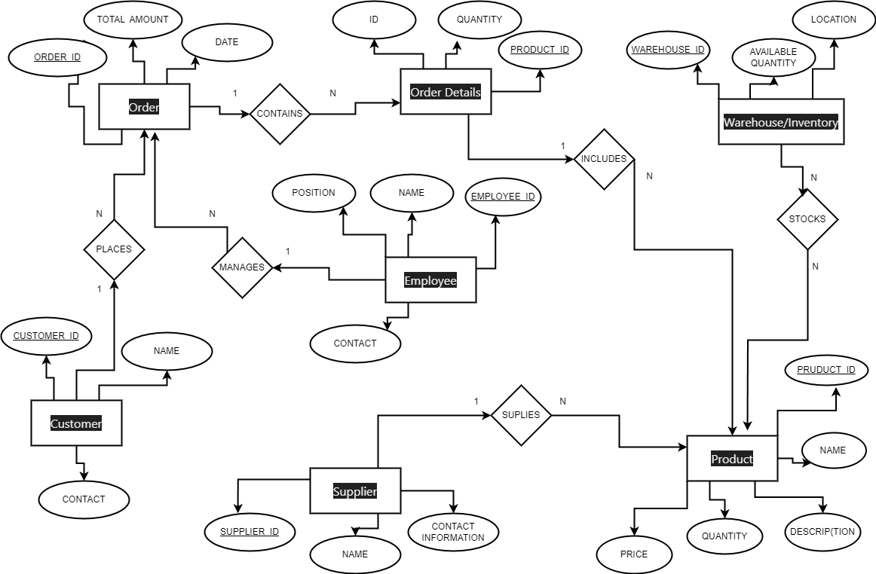
Entity Relationship Diagram

Slide 7

Data Dictionary

Slide 8
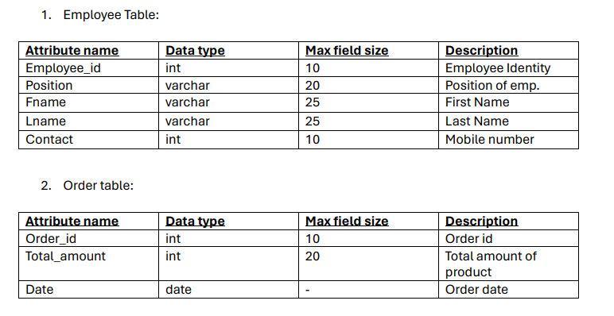
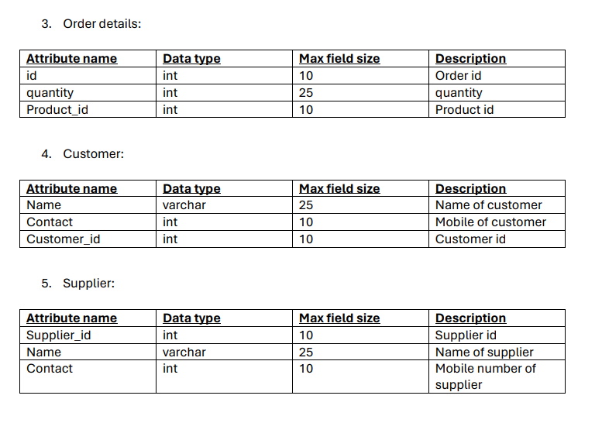
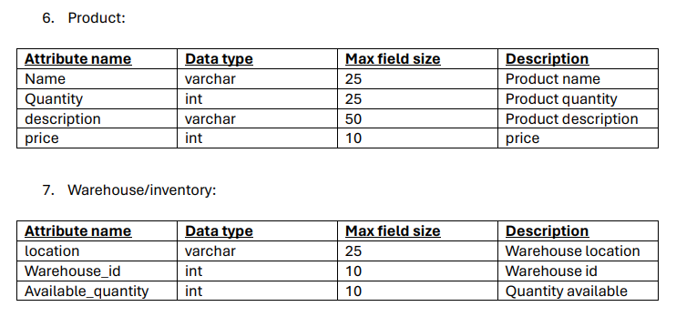

Slide 9

DDL for Table creation

Slide 10
Table creation SQL Commands
1. Employees
CREATE TABLE employees (
Employee_id INT(10) PRIMARY KEY,
Position VARCHAR(20),
Fname VARCHAR(25),
Lname VARCHAR(25),
Contact INT(10)
);
2. Customer
CREATE TABLE customer (
Customer_id INT(10) PRIMARY KEY,
Name VARCHAR(25),
Contact INT(10)
);
3. Product
CREATE TABLE product (
Product_id INT PRIMARY KEY,
Name VARCHAR(25),
Quantity INT(25),
description VARCHAR(50),
price INT(10),
Supplier_id INT,
FOREIGN KEY (Supplier_id) REFERENCES supplier(Supplier_id)
);

Slide 11
4. Order details
CREATE TABLE order_details (
Order_id INT(10) PRIMARY KEY,
Total_amount INT(20),
Date DATE
);
5. order_table
CREATE TABLE order_table (
Order_id INT PRIMARY KEY,
Date DATETIME, -- Stores both date and time of the order
Total_amount DECIMAL(10,2), -- Adjust precision if needed
Customer_id INT,
Employee_id INT,
FOREIGN KEY (Customer_id) REFERENCES customer(Customer_id),
FOREIGN KEY (Employee_id) REFERENCES employees(Employee_id)
);
6. Warehouse
CREATE TABLE warehouse (
Warehouse_id INT(10) PRIMARY KEY,
location VARCHAR(25),
Available_quantity INT(10),
Product_id INT, -- Optional foreign key to link to the 'product' table
FOREIGN KEY (Product_id) REFERENCES product(Product_id)
);
7. Supplier
CREATE TABLE supplier (
Supplier_id INT(10) PRIMARY KEY,
Name VARCHAR(25),
Contact INT(10)
);

Slide 12

Simple queries

Slide 13
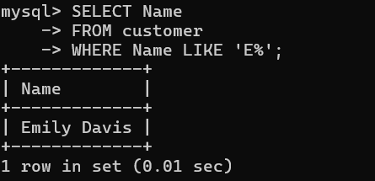
Query : List the customers with names starting with the letter 'E'

Slide 14
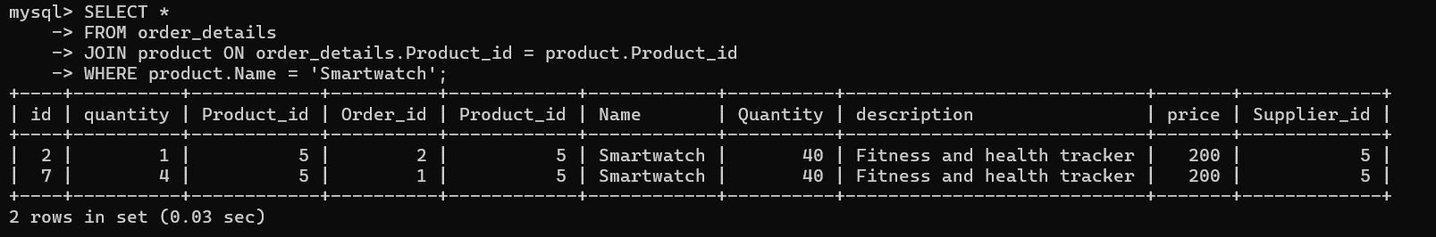
Query : List all order details which includes a “Smartwatch”

Slide 15
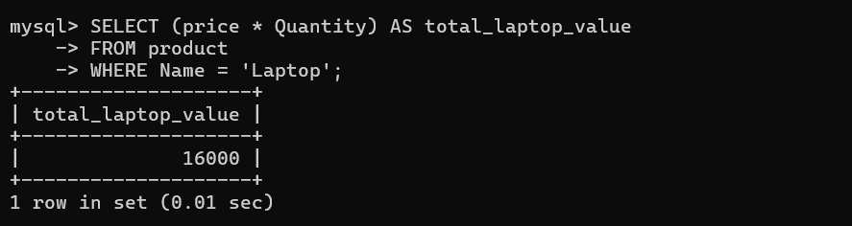
Query : Calculate the total value of the 'Laptop' inventory (price * quantity).

Slide 16

Complex queries

Slide 17
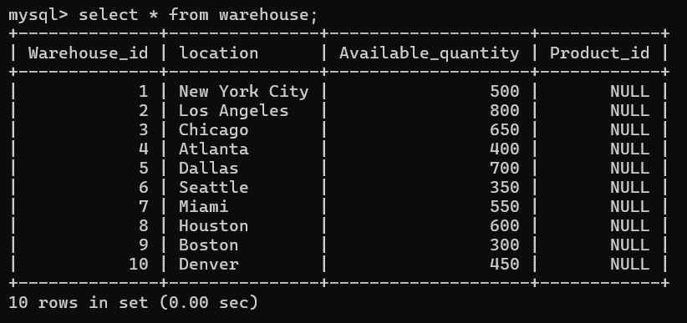
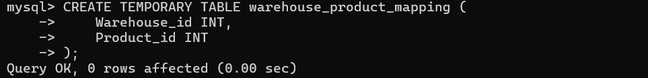
Query- Adding values to a column all together.
1.Existing table.
2.Creating a new temporary table

Slide 18
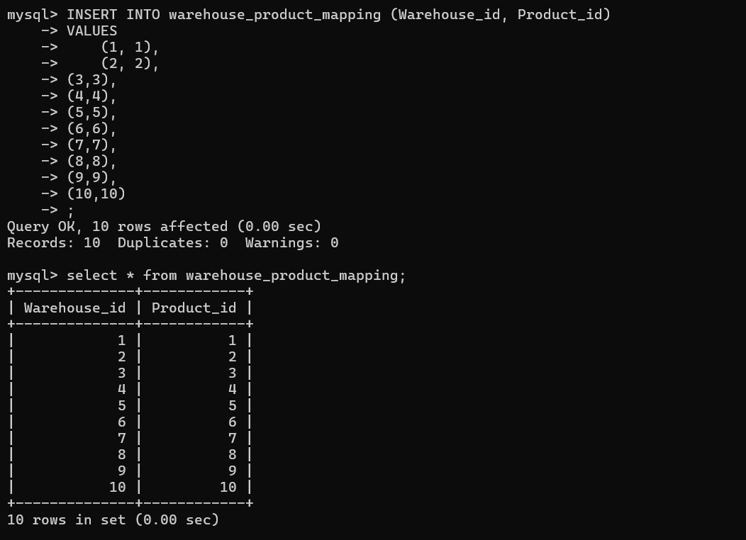
Query- adding values to a column which all together.
Continued…
3. Adding the column in the temporary table

Slide 19
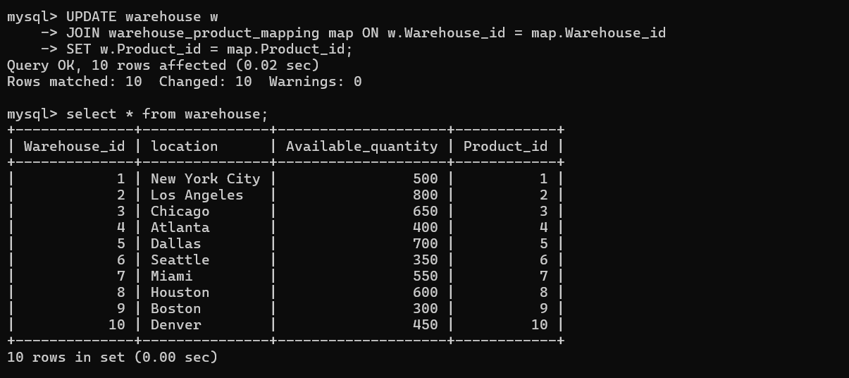
Query- adding values to a column which all together.
Continued…
4.Joining the temporary table with the warehouse table…

Slide 20
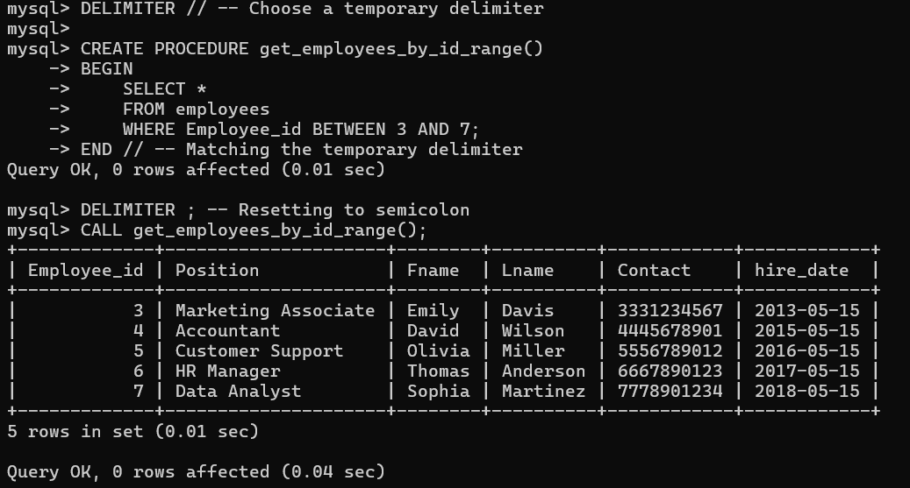
Query :create a procedure to select employees whose employee_id between 3 to 7

Slide 21
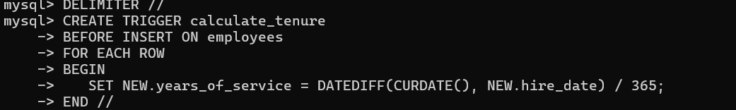
Trigger to calculate tenure of employees:

Slide 22
Thank you!

